Slide 1


Amazon SageMaker: Your End-to-End Machine Learning Platform
Amazon SageMaker is a comprehensive machine learning (ML) platform that empowers data scientists and developers to build, train, and deploy ML models quickly and efficiently. It provides a fully managed environment with tools and resources for every stage of the ML lifecycle, from data preparation to model deployment and monitoring.
by neema Ngari

Slide 2

SageMaker Studio: Your Centralized ML Hub
SageMaker Studio serves as your central hub for all your ML activities. This web-based interface provides a unified workspace for data exploration, model building, training, deployment, and monitoring. It offers a streamlined workflow and intuitive tools to accelerate your ML journey.
Jupyter Notebooks
Create and share interactive notebooks for code exploration, data analysis, and model prototyping.
Experiment Tracking
Organize and track experiments, compare different models, and visualize results to optimize your models.
Model Registry
Store, version, and manage your trained models for easy access and deployment.
SageMaker Debugger
Identify and resolve training issues early on with built-in debugging tools and visualizations.

Slide 3
Data Preparation and Feature Engineering
SageMaker provides a suite of tools and algorithms for preparing and transforming your data for ML. You can access and process data from various sources, including Amazon S3, Redshift, and other data lakes.
Data Wrangling
Feature Engineering
Data Labeling
Use built-in libraries and algorithms for cleaning, transforming, and enriching your data to make it suitable for ML models.
Label your data for supervised learning tasks, using manual labeling, automated tools, or crowdsourcing platforms.
Create new features by combining existing ones, using domain expertise, and applying feature selection techniques to improve model performance.

Slide 4

Model Building and Training
SageMaker offers a wide range of pre-built ML algorithms for both supervised and unsupervised learning, as well as the ability to bring your own algorithms. You can train models using various frameworks, such as TensorFlow, PyTorch, and MXNet.
1
Built-in Algorithms
Access a library of pre-trained algorithms for common ML tasks, such as classification, regression, and clustering.
2
Bring Your Own Algorithm
Use your own custom algorithms and frameworks, ensuring flexibility and control over your ML solutions.
3
Distributed Training
Train large models efficiently by distributing the workload across multiple instances, accelerating the training process.
4
Hyperparameter Tuning
Optimize model parameters for better performance using automated hyperparameter tuning techniques.

Slide 5
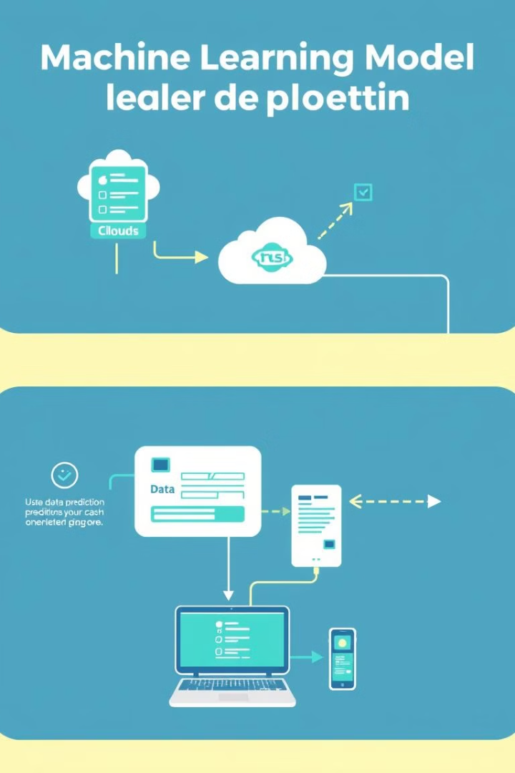



Model Deployment and Monitoring
Once your model is trained, SageMaker enables easy and seamless deployment to production environments. You can choose from various deployment options, including real-time inference, batch inference, and serverless deployment.
Model Deployment
Deploy your trained model as a web service for real-time predictions or batch processing.
Endpoint Configuration
Configure the deployment environment, including instance type, resources, and scaling options, for optimal performance.
Model Monitoring
Continuously monitor your deployed models to track their performance, detect data drift, and ensure model integrity.

Slide 6
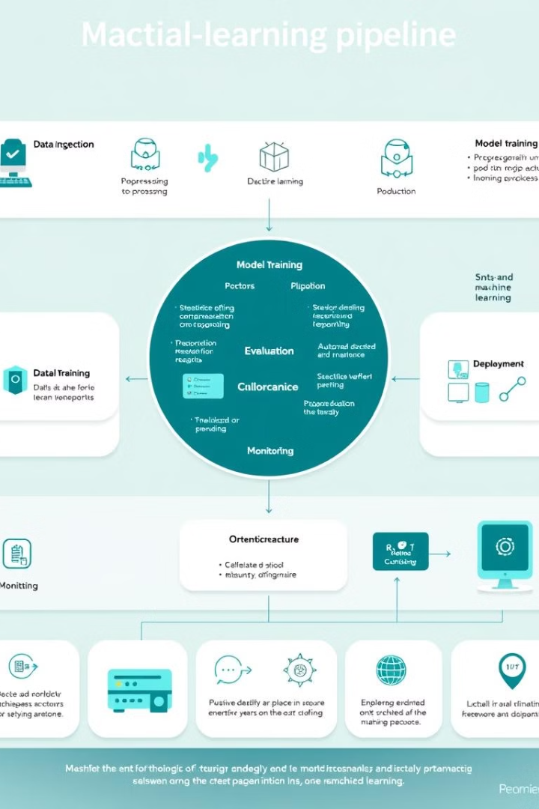
SageMaker Pipelines: Automating Your ML Workflow
SageMaker Pipelines provides a framework for building, automating, and managing end-to-end ML workflows. It enables you to define a series of steps, from data preparation to model deployment, and automate the execution of these steps.
Feature
Description
Workflow Orchestration
Define and manage complex ML workflows, including data processing, model training, and deployment.
Version Control
Track changes to your pipeline code, making it easier to collaborate, reproduce results, and roll back to previous versions.
Reusable Components
Create reusable components, such as data preprocessing steps and model training scripts, for efficient pipeline development.

Slide 7





SageMaker Ground Truth: Efficient Data Labeling
SageMaker Ground Truth is a service that simplifies the process of labeling data for machine learning. It provides tools and workflows for managing, labeling, and validating data, enabling you to build high-quality training datasets.
Manual Labeling
Label data manually through a user-friendly interface, allowing for accurate and precise annotations.
Automated Labeling
Utilize pre-trained models and algorithms to automate the labeling process, accelerating the dataset creation process.
Crowd Labeling
Leverage crowdsourcing platforms to scale data labeling efforts, providing access to a large pool of annotators.
Quality Control
Monitor and evaluate the quality of your labeled data with quality checks and validation mechanisms.

Slide 8

SageMaker Feature Store: Centralized Feature Management
SageMaker Feature Store provides a centralized repository for storing, managing, and serving features used for machine learning. It simplifies feature engineering, reduces data duplication, and enables faster model development and deployment.
1
Feature Creation
Create and store features from various sources, including data lakes, databases, and streaming data.
2
Feature Serving
Serve features to ML models during training and inference, ensuring consistency and efficiency.
3
Feature Versioning
Track feature changes and versions, enabling reproducibility and traceability of ML workflows.
4
Feature Lineage
Understand the origin and dependencies of features, facilitating debugging and auditing.

